Slide 1


CPU Design and Verification
: RISC-V_APB BUS_Peripherals
발표자: 김지환
팀원: 김태민, 박지수, 함영은

Slide 2
Contents
01.
Introduction
02.
ABP BUS Specification
03.
Waveform of Peripherals
04.
Conclusion

Slide 3
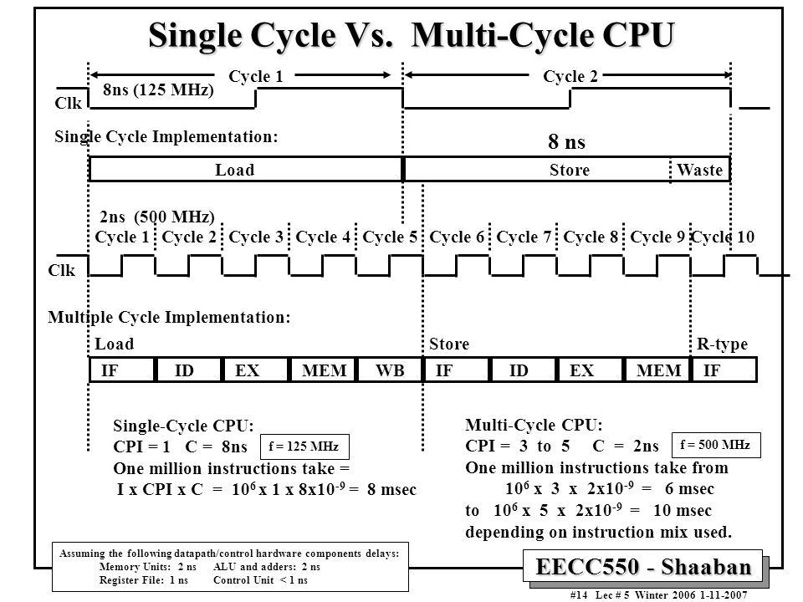
01. Introduction
Notes:
저번에 설계했던 싱글 사이클 CPU를 멀티 사이클 CPU로 업그레이드 시켰음
이렇게 함으로써 우리는 각 명령어마다 각기 다른 처리 속도를 가지는데
낭비를 최소한으로 하는 조금 더 성능이 좋은 CPU로 만들었음

Slide 4
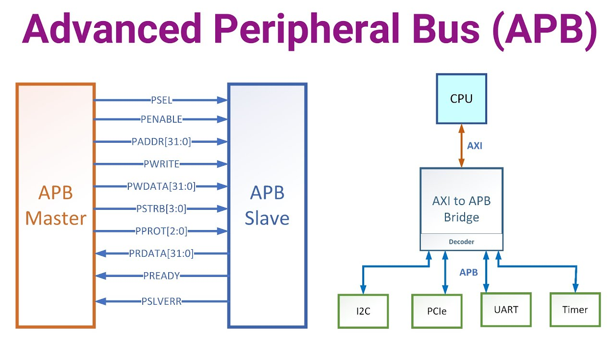
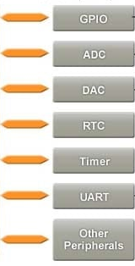

01. Introduction
Project Goal

Slide 5
01. Introduction
Main Contents

Slide 6


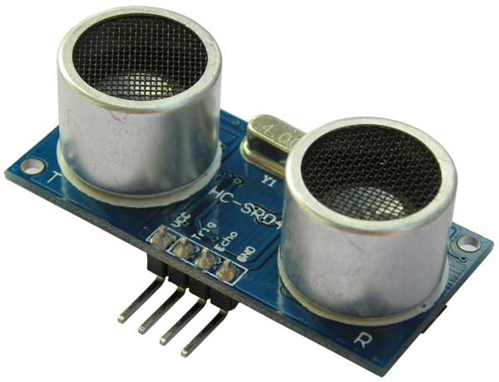
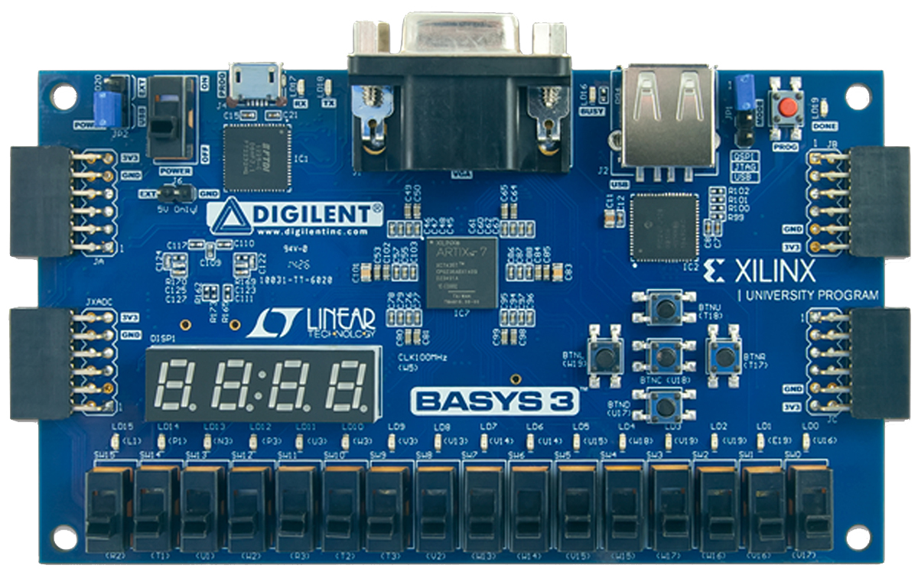
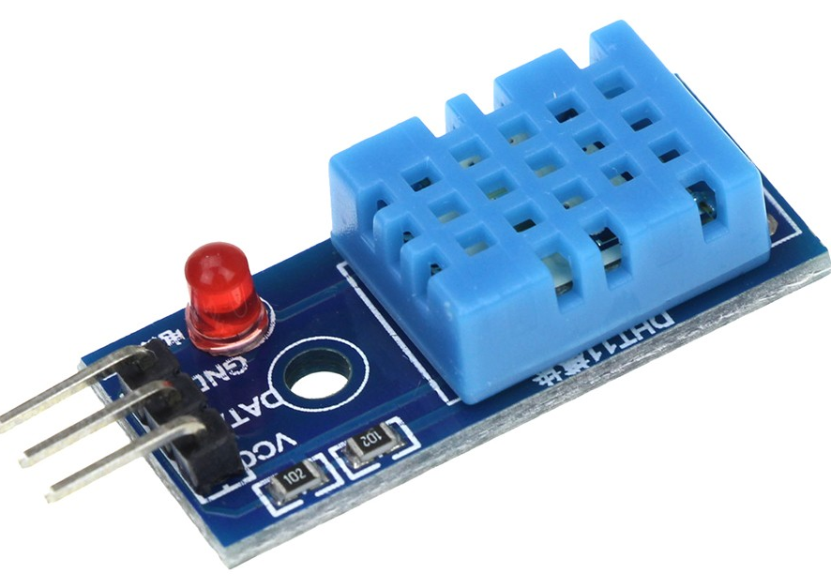
01. Introduction

Slide 7

02. APB Bus Specification

Slide 8
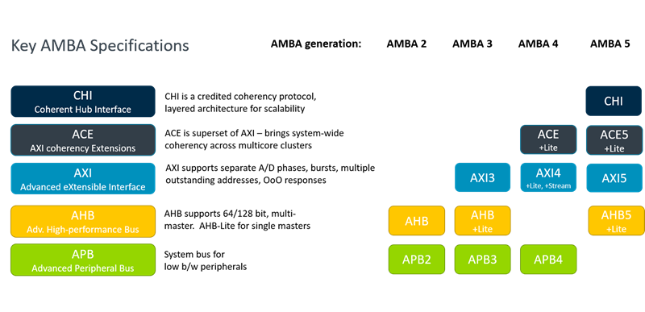
02. APB Bus Specification

Slide 9
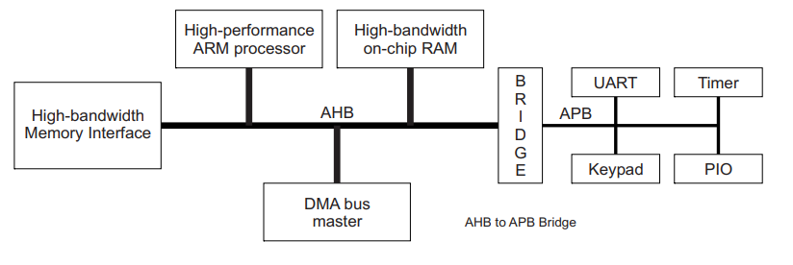
02. APB Bus Specification

Slide 10
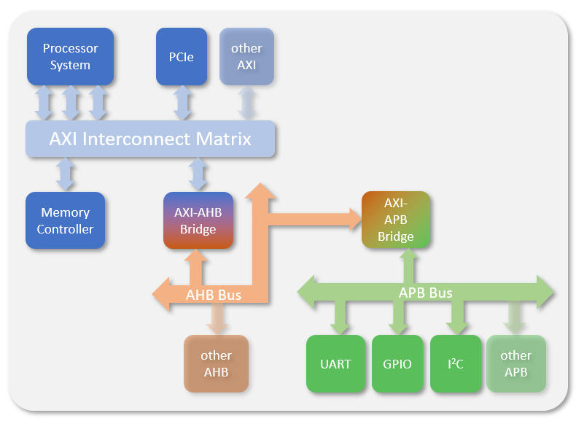
02. APB Bus Specification

Slide 11
02. APB Bus Specification

Slide 12
02. Block Diagram

Slide 13
03. Waveform by type

Slide 14
03. Waveform by type
R-Type
1. Rom_data -> RegFile RAddr
2. RegFile Rdata1, 2 -> ALU
3. ALU -> 5x1 wdMux
4. 5x1 wdMux -> RegFile WData

Slide 15
03. Waveform by type
R-Type

Slide 16
03. Waveform by type
R-Type

Slide 17
03. Waveform by type
L-Type

Slide 18
03. Waveform by type
L-Type

Slide 19
03. Waveform by type
I-Type

Slide 20
03. Waveform by type
I-Type

Slide 21
03. Waveform by type
S-Type

Slide 22
03. Waveform by type
S-Type

Slide 23
03. Waveform by type
B-Type

Slide 24
03. Waveform by type
B-Type

Slide 25
03. Waveform by type
LU-Type

Slide 26
03. Waveform by type
AU-Type

Slide 27
03. Waveform by type
J, JL-Type

Slide 28
03. Waveform by type
U, J-Type

Slide 29
04. Conclusion
Notes:
향후 개선 방향(예: 인터페이스 개선, 추가 기능 확장)

Slide 30
Thank you

